Slide 1
Virtual Kubernetes Cluster
Kubernetes Community Days Chennai 28 May 2022

Slide 2

About KCD Chennai 2022
A community-organized online conference supported by the Cloud Native Computing Foundation (CNCF). It gathers adopters, technologists and students from open source and cloud-native communities for education, collaboration and networking.
When: 3-4 June 2022
3 Tracks: Developer, DevOps, Beginners
4 Keynotes, 28 Breakout sessions, 2 Workshops
T-Shirt swag to all attendees, $1000 worth cloud credits, 20% discount on KCNA/CKA/CKAD/CKS
RSVP: kcdchennai.in

Slide 3


Speakers
Chidambaranathan R (Nathan)
Principal Software Engineer @Ericsson
Twitter: @rcnathan
Raman N
Senior Software Engineer @Ericsson
Twitter: @raman_n

Slide 4
Agenda
Origin Story
What is vcluster?
Live Demo
Use cases
FAQs
Q&A

Slide 5

Origin Story

Slide 6

Challenges for Product Development Team
Development Environment
Less freedom of choice for developers
Less flexibility in CI/CD pipelines
Source: What Is a Test Environment? A Guide to Managing Your Testing - Testim.io

Slide 7
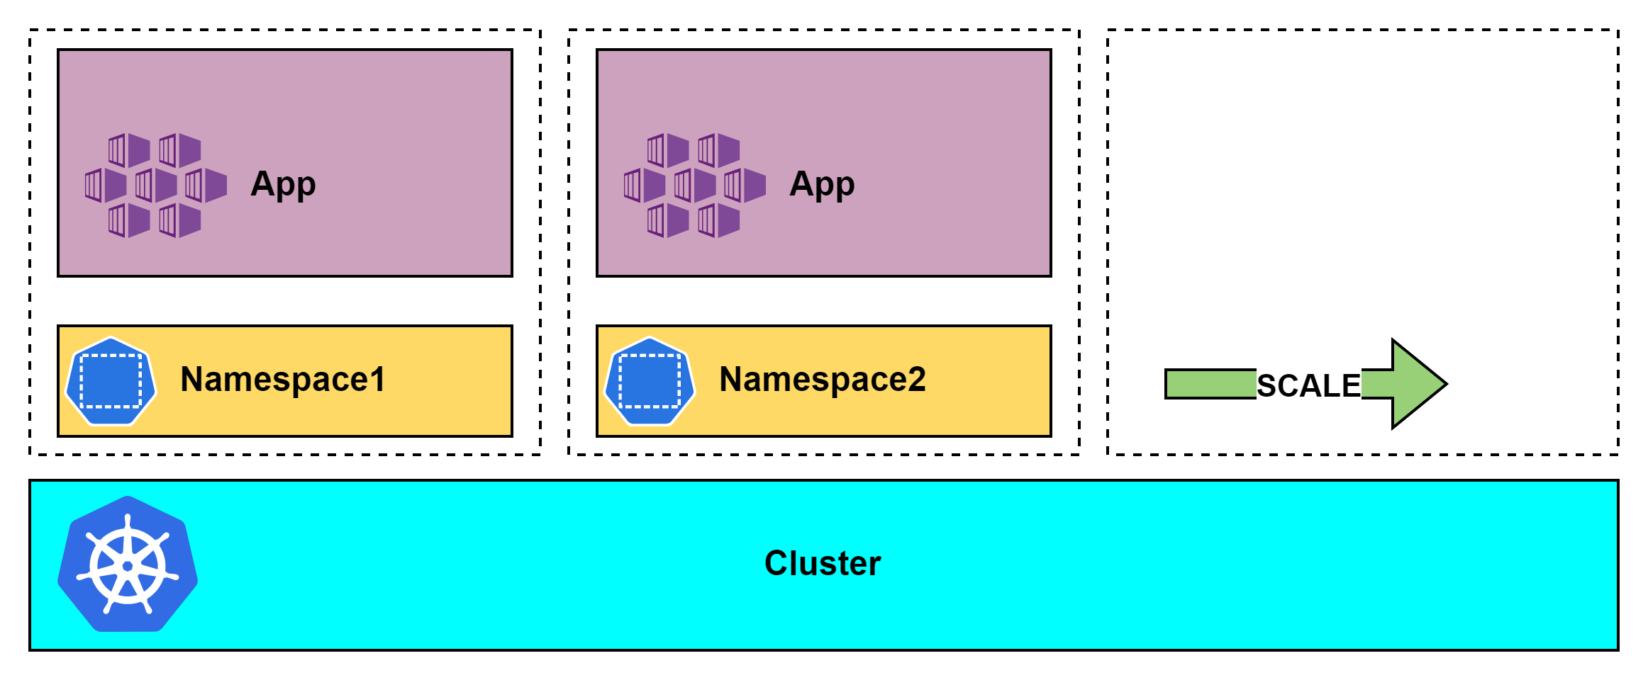
Development Environment – Namespace Isolation
Challenges
Managing cluster wide resources

Slide 8
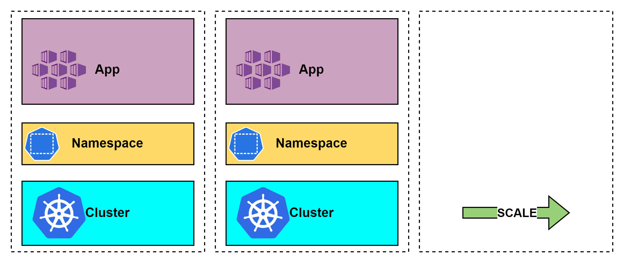

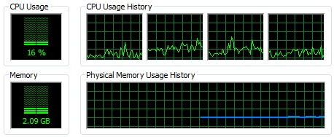
Development Environment – Cluster Isolation
Challenges
Cost
Complexity
Utilization
Example:
Per cluster cost: INR 50K
For 10 members: INR 500K

Slide 9
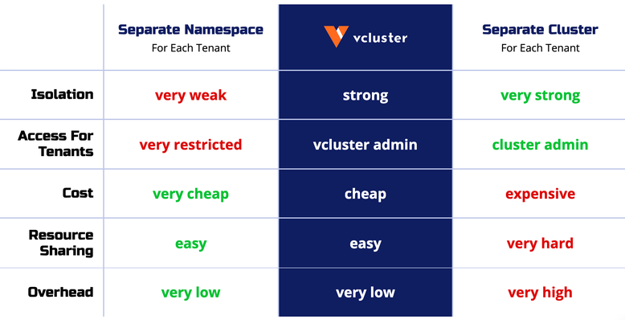
Development Environment – Namespace Vs Cluster Isolation
V/S
Is there something in the middle?
Source: What are Virtual Kubernetes Clusters? | vcluster docs | Virtual Clusters for Kubernetes

Slide 10

Can’t I manage in my Local Workstation?

Slide 11

Less freedom of choice for developers
Central Admin team control

Slide 12



Less freedom of choice for developers

Slide 13
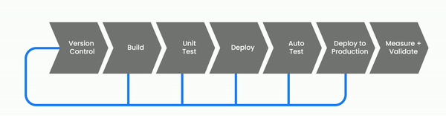
Less flexibility in CI/CD pipelines
Challenges
Testing against multiple K8s versions
Feedback loop time
Source: CI/CD Pipeline: Demystifying The Complexities - Java Code Geeks - 2022

Slide 14
Challenges for Product Development Team
Development Environment
Less freedom of choice for developers
Less flexibility in CI/CD pipelines
Source: What Is a Test Environment? A Guide to Managing Your Testing - Testim.io

Slide 15


Slide 16



What is vcluster?
Fully working Kubernetes Cluster that runs on top of another Kubernetes cluster

Slide 17


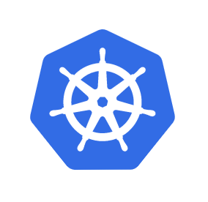


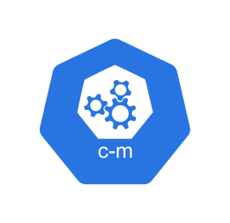

What is vcluster? – Control Plane
Pod 1
Pod 2
Workloads
Namespace1
Namespace2
Namespace3
API Server
Data Store (etcd)
Controller Manager
Scheduler
Control Plane

Slide 18
What is vcluster? – Control Plane
API Server
Workloads
Control Plane Running As Pod
Namespace1
Namespace2
Namespace3
API Server
Data Store (etcd)
Controller Manager
Scheduler
Control Plane
Host Cluster

Slide 19
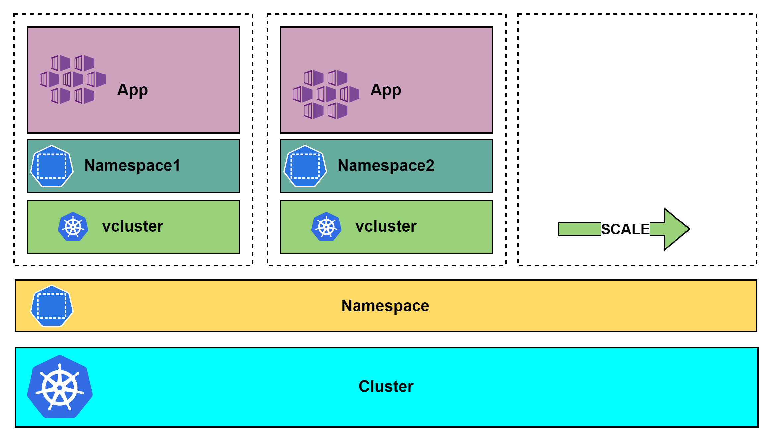

Cluster Isolation Vs vcluster
Host Cluster
Without vcluster
With vcluster

Slide 20

Demo – Quick Start
How does it work

Slide 21


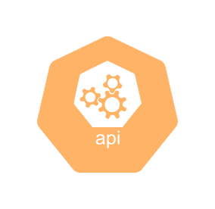

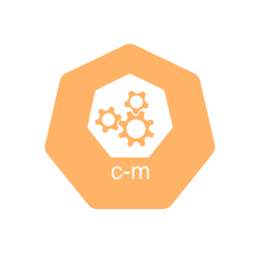


vcluster Architecture
Supported Distros
K0s
Vanilla K8s
EKS
K3s (Default)
vcluster service
vcluster pod
vcluster connect vc1
-n host-namespace
API Server
+ Controller Manager
Data Store
(sqlite, etcd, …)
Syncer
Vcluster Statefulset (vc1)
vcluster create vc1
-n host-namespace
host-namespace
kubectl create namespace
host-namespace
API Server
Data Store (etcd)
Controller
Manager
Scheduler
Control Plane Of Host Cluster

Slide 22


vcluster Architecture
vcluster
sample
Sample-pod-1
Sample-pod-2
Namespace
Deployment
Pod1
Pod2
kubectl create deployment sample
-n ns1 --image=nginx --replicas 2
ns1
kubectl create namespace ns1
vcluster service
vcluster pod
(K3s)
API Server
+ Controller Manager
Data Store
(sqlite, etcd, …)
Syncer
Syncer
Host Cluster
Vcluster Statefulset (vc1)
host-namespace

Slide 23


vcluster Architecture
vcluster
sample
Sample-pod-1
Sample-pod-2
Sample-pod-1
Sample-pod-2
ns1
ns2
vcluster service
vcluster pod
Sample-pod-1
scheduler
API Server
+ Controller Manager
Syncer
Sample-pod-2
Data Store
(sqlite, etcd, …)
Syncer
Vcluster Statefulset (vc1)
host-namespace
kube-system
Host Cluster

Slide 24
vcluster Architecture
vcluster
sample
Sample-pod-1
Sample-pod-2
Sample-pod-1
Sample-pod-2
ns1
ns2
vcluster service
vcluster pod
Sample-pod-1-x-ns1-x-vc1
scheduler
API Server
+ Controller Manager
Data Store
(sqlite, etcd, …)
Syncer
Sample-pod-2-x-ns1-x-vc1
Sample-pod-1-x-ns2-x-vc1
Vcluster Statefulset (vc1)
Sample-pod-2-x-ns2-x-vc1
host-namespace
kube-system
Host Cluster

Slide 25
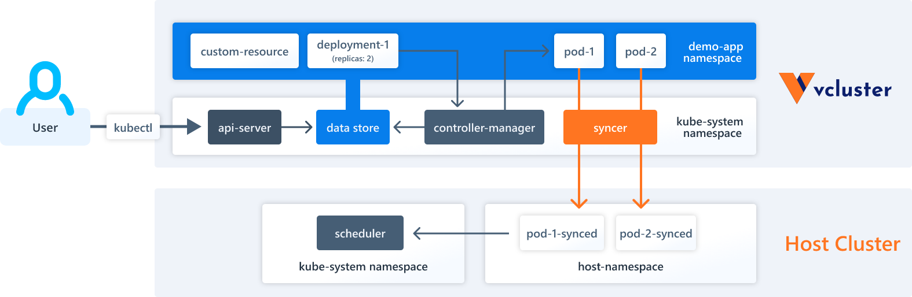
Kubernetes Resources inside vcluster
High-level = Purely Virtual
Low-Level = Sync'd Resources

Slide 26
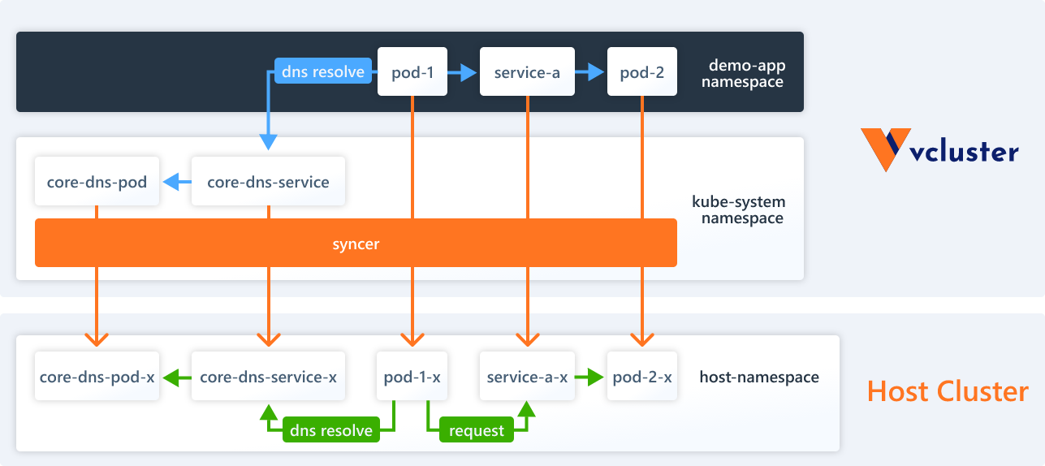
Network & DNS inside vcluster – Pod, Service
Pod-To-Pod Traffic
cluster-internal IP addresses
Pod-To-Service Traffic
DNS
Source: Network & DNS | vcluster docs | Virtual Clusters for Kubernetes

Slide 27


Network & DNS inside vcluster – Ingress Traffic
vcluster
vcluster
Ingress Rules
Ingress Rules
Host Cluster

Slide 28
Nodes
Fake Nodes (Default)
Real Nodes
Real Nodes All
Real Nodes Label Selector

Slide 29


Slide 30

Environment Setup

Slide 31
DEMO - How to expose and access vcluster?
Accessing vcluster
With vcluster cli
Service Account
Without vcluster cli
Admin
Exposing vcluster
Loadbalancer service
NodePort service
Ingress
In-Cluster
vcluster service
vcluster pod
API Server
+ Controller Manager
Data Store
(sqlite, etcd, …)
Syncer
Vcluster Statefulset (vc1)
host-namespace

Slide 32


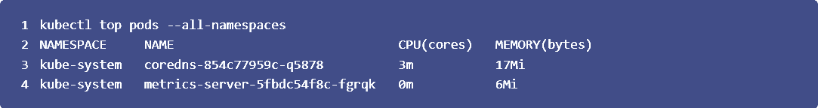
DEMO - Monitoring the vcluster
.sync.nodes.enabled: true
Host Cluster

Slide 33
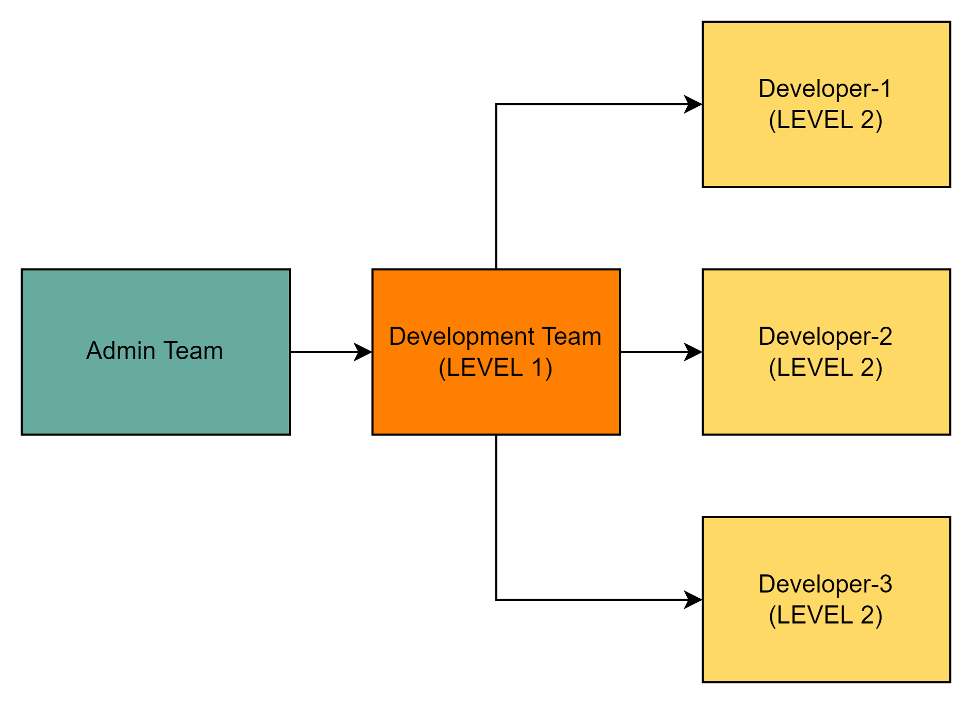
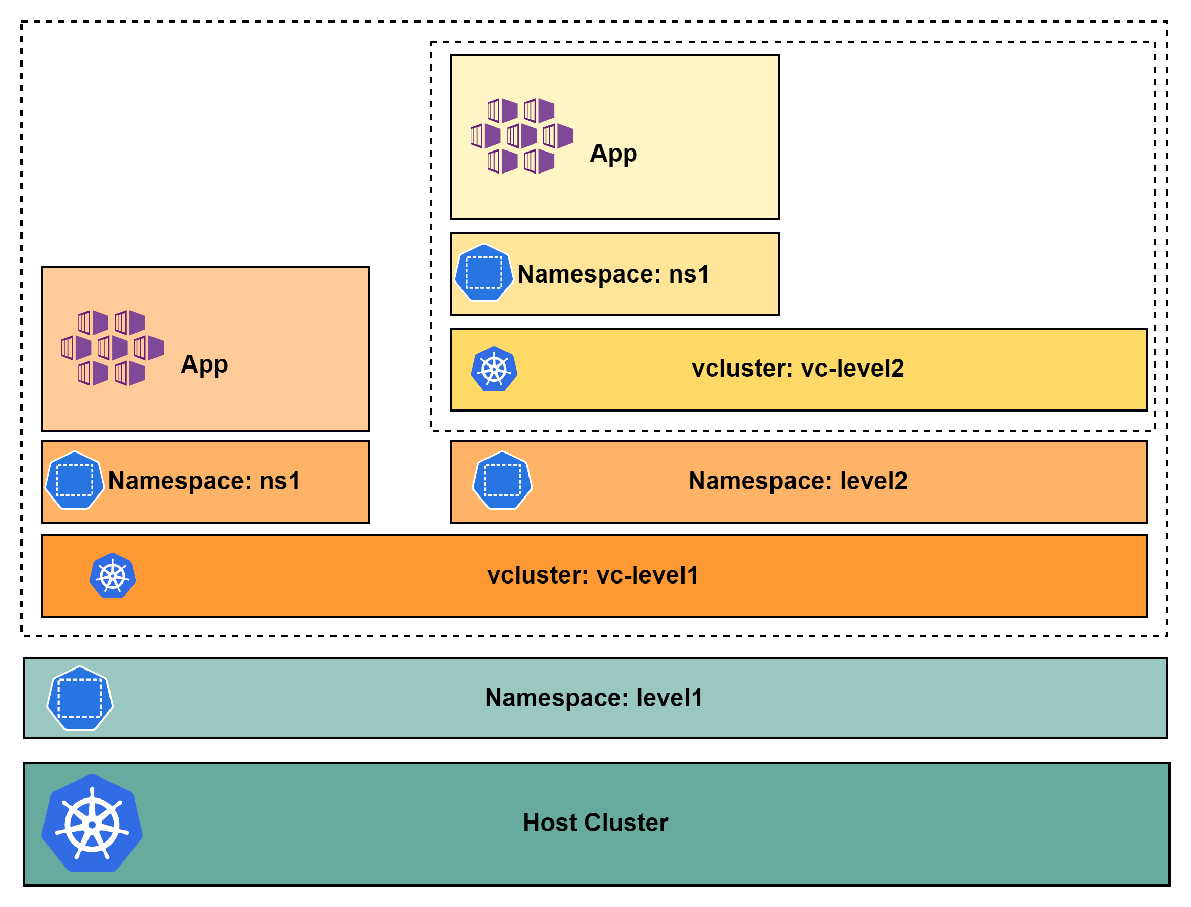
DEMO - vcluster inception
Use Case
DEMO Implementation

Slide 34


DEMO – Data Store with/without PV?
vcluster service
vcluster pod
Embedded SQLite (default with PV)
PostgreSQL
MySQL
MariaDB
etcd
API Server (K3s)
+ Controller Manager
Data Store
(sqlite, etcd, …)
Syncer
Vcluster Statefulset (vc1)
PVC
Storage.persistence: false
Storage.persistence: true
host-namespace
PV
emptyDir
Host Cluster

Slide 35
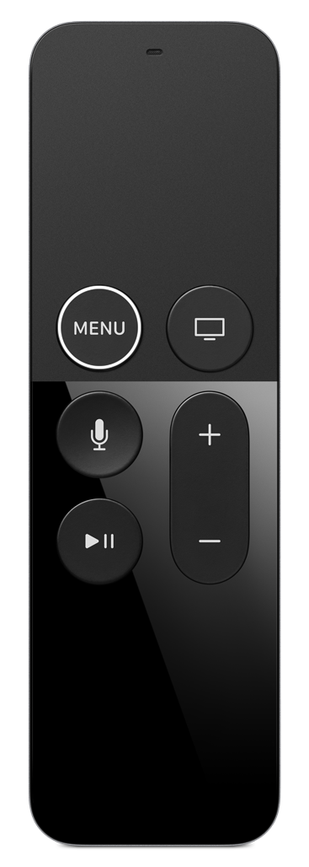
DEMO - Pausing and Resuming vcluster
vcluster
sample
Sample-pod-1
Sample-pod-2
Sample-pod-1
Sample-pod-2
ns1
ns2
vcluster service
vcluster pod
Sample-pod-1-x-ns1-x-vc1
scheduler
API Server
+ Controller Manager
Data Store
(sqlite, etcd, …)
Syncer
Sample-pod-2-x-ns1-x-vc1
Sample-pod-1-x-ns2-x-vc1
Vcluster Statefulset (vc1)
Sample-pod-2-x-ns2-x-vc1
PV
host-namespace
kube-system
Host Cluster

Slide 36
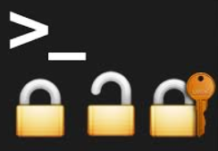
DEMO - Running vcluster as a non-root user
Host Cluster

Slide 37
Other Features
Isolation
Default
Full control-plane isolation
DNS isolation
Single namespace
Isolated Mode
Pod Security Standard
Resource Quota/Limit Range
Network Policy
vcluster create … --isolate
High Availability
Only in vanilla K8s distribution
vcluster create ... --distro k8s -f values.yaml

Slide 38
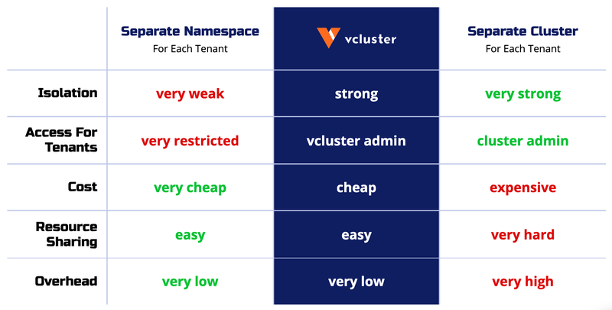
Namespace Vs Cluster Vs vcluster
Source: What are Virtual Kubernetes Clusters? | vcluster docs | Virtual Clusters for Kubernetes

Slide 39
Use Cases
Development Test Environment
Exclusive development test environment per developer
Continuous Integration
Parallel verification of multiple variants of Product installation
Parallel verification of same Product on multiple Kubernetes versions

Slide 40


Slide 41
How does vcluster compare to K8s hierarchical namespaces?
Hierarchical namespaces
(Virtual) Clusters
Custom Resource Definition (CRD)

Slide 42
Can I use vcluster inside a cloud system eg: azure AKS, etc?
On-Prem
HCP

Slide 43
How do you deal with system updates and k8s upgrades gracefully with vcluster?
Supported Distros
K0s
Vanilla K8s
EKS
K3s (Default)
Host Cluster

Slide 44
If the pods are all in the Host (non-virtual) cluster, how well isolated are they from one another?
vcluster
sample
Sample-pod-1
Sample-pod-2
Sample-pod-1
Sample-pod-2
ns1
ns2
vcluster service
vcluster pod
Sample-pod-1-x-ns1-x-vc1
Isolated Mode
scheduler
API Server
+ Controller Manager
Data Store
(sqlite, etcd, …)
Syncer
Sample-pod-2-x-ns1-x-vc1
Sample-pod-1-x-ns2-x-vc1
Vcluster Statefulset (vc1)
Sample-pod-2-x-ns2-x-vc1
host-namespace
kube-system
Host Cluster

Slide 45
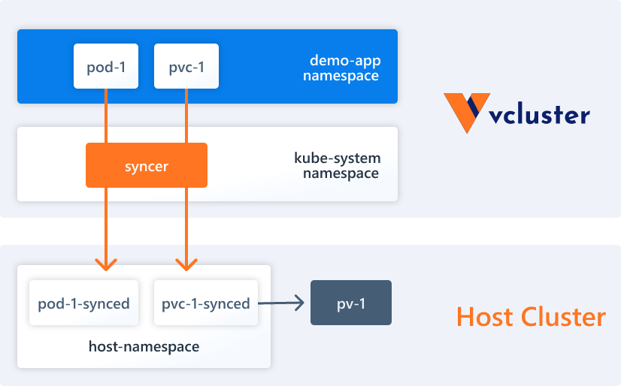
How persistence storage works on vcluster?
Source: Storage | vcluster docs | Virtual Clusters for Kubernetes

Slide 46
Documentation and Support
Website: https://www.vcluster.com/
Documentation: https://www.vcluster.com/docs/what-are-virtual-clusters
GitHub: https://github.com/loft-sh/vcluster
Slack: https://slack.loft.sh

Slide 47


Slide 48
Thank you

